Slide 1
Quantifying the treatment effects on prolonging the freshness of apples, bananas and avocados
Prepared by
Bill Chung, Justin Trobec, Nobu Yamaguchi
Notes:
Today, our team Bill, Justin and I are going to explain our experiment: Quantifying the treatment effect on prolonging the freshness of apples, bananas and avocados.

Slide 2
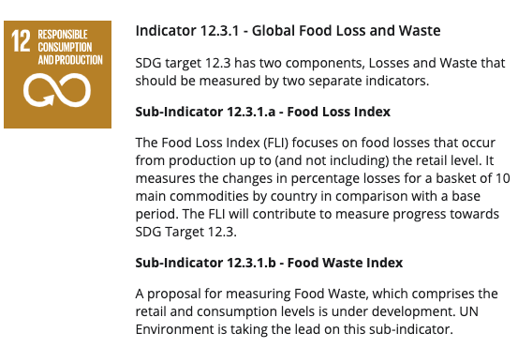
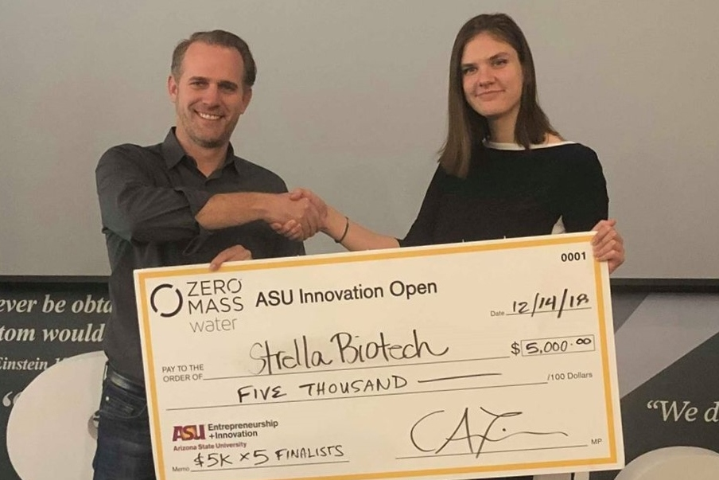
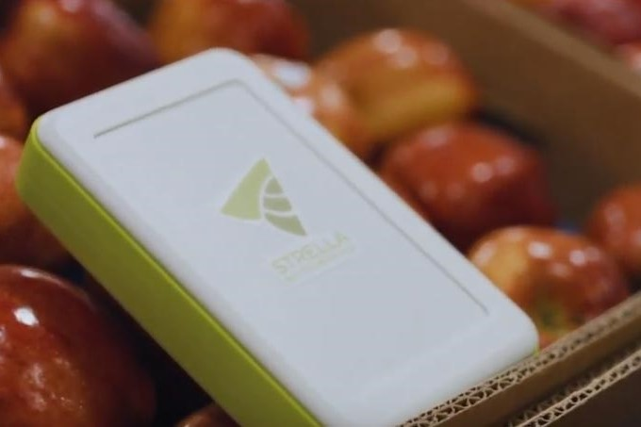
Research question
Reducing food waste is a global problem.
Finding a good way to keep the food fresh for a long time is important for our lives.
Many startups that tackle this problem.
Although those startups try to implement very complex methods, we can do something in much simpler way.
Especially people like very simple way to store foods efficiently in their home.
Notes:
Reducing food waste and food loss is a global problem and one of the SDGs topics. So, finding a good way to keep the food fresh for a long time is important for our lives.
There are many startups that tackle this problem. A startup in East Coast tries to find out the best timing to eat apples by measuring the ethylene gas. This company has already raised $3.8M, which shows reducing food waste has a big business impact. Moreover, several companies developed special containers which can keep the freshness of the food inside the container. Although those startups try to implement very complex methods, we can do something in much simpler way.
Especially people like very simple way to store foods efficiently in their home because they don’t want to pay a lot of money for this problem and they can’t continue complicated habits.

Slide 3
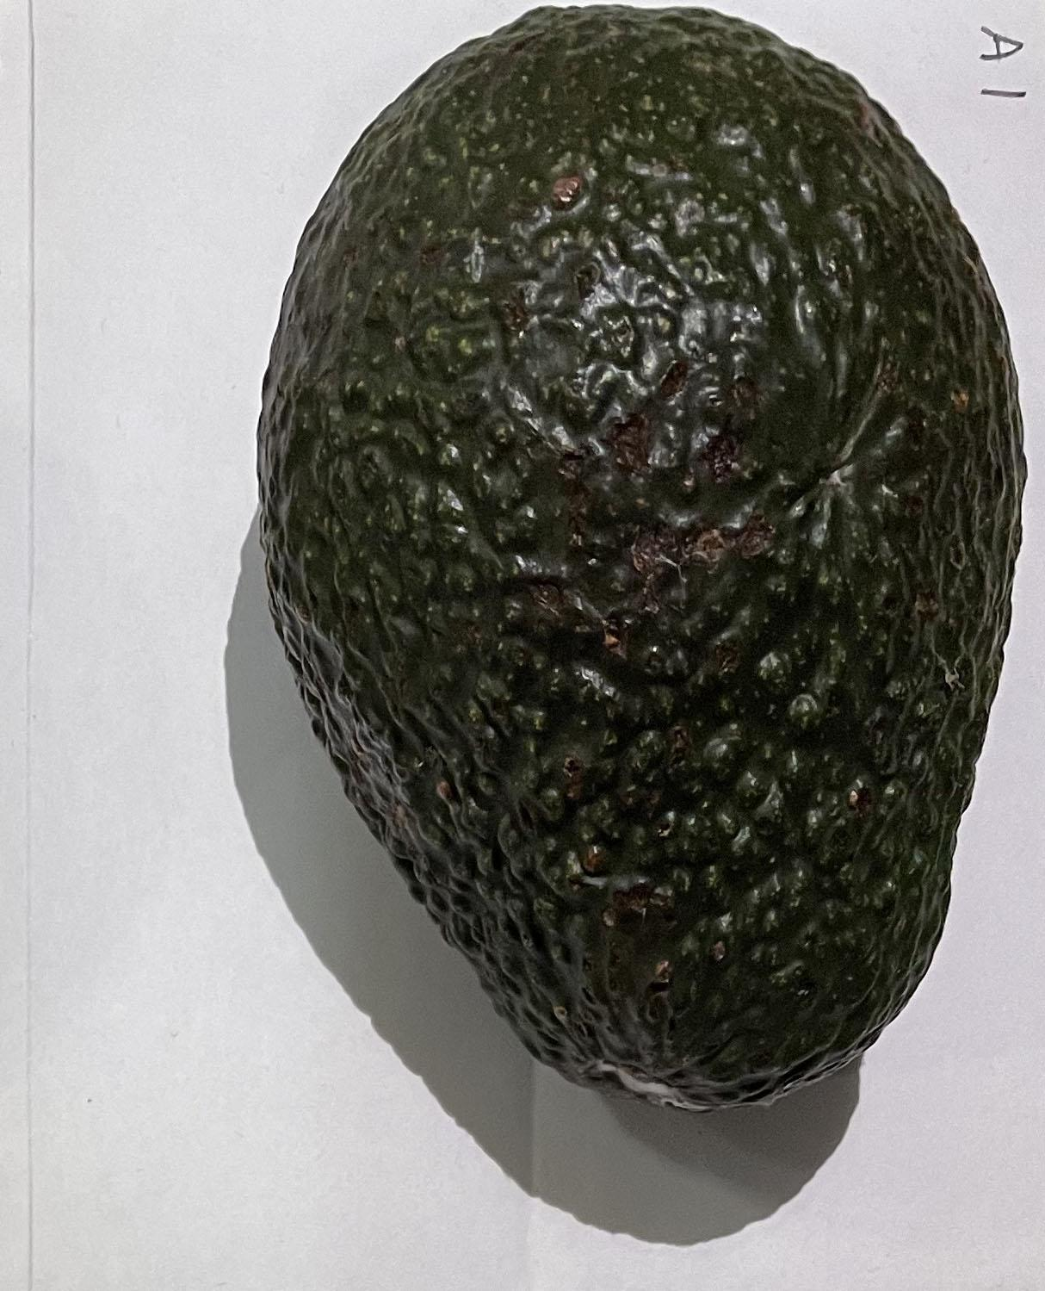
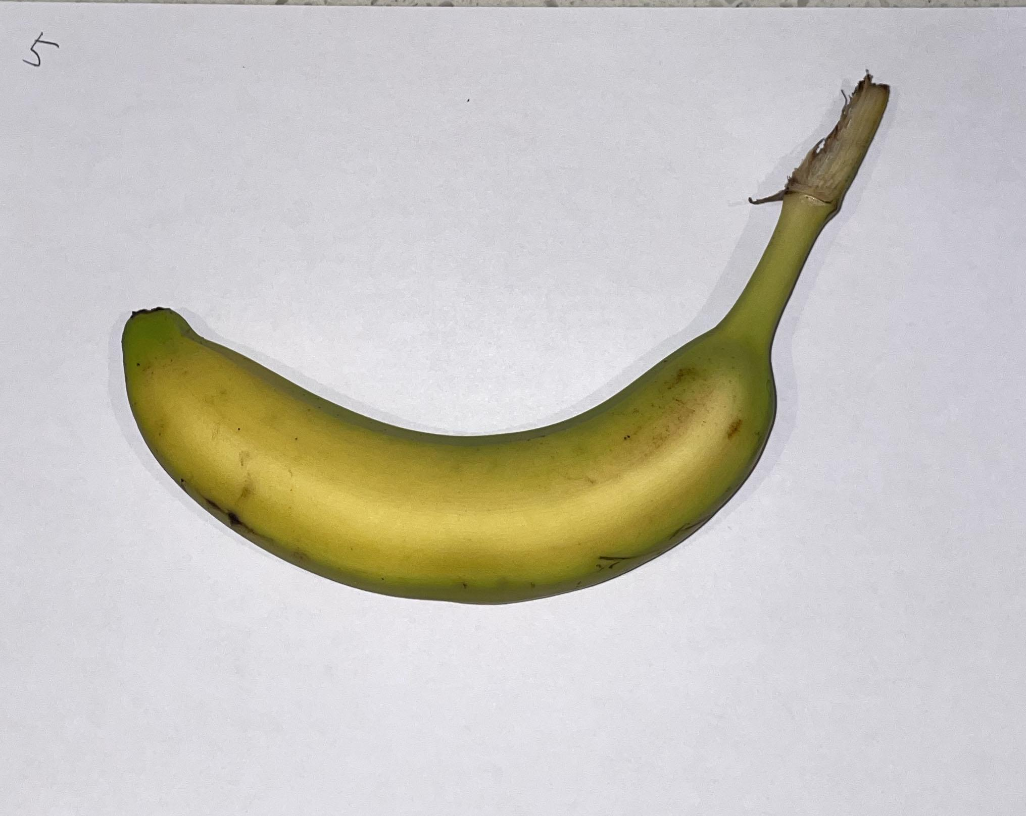
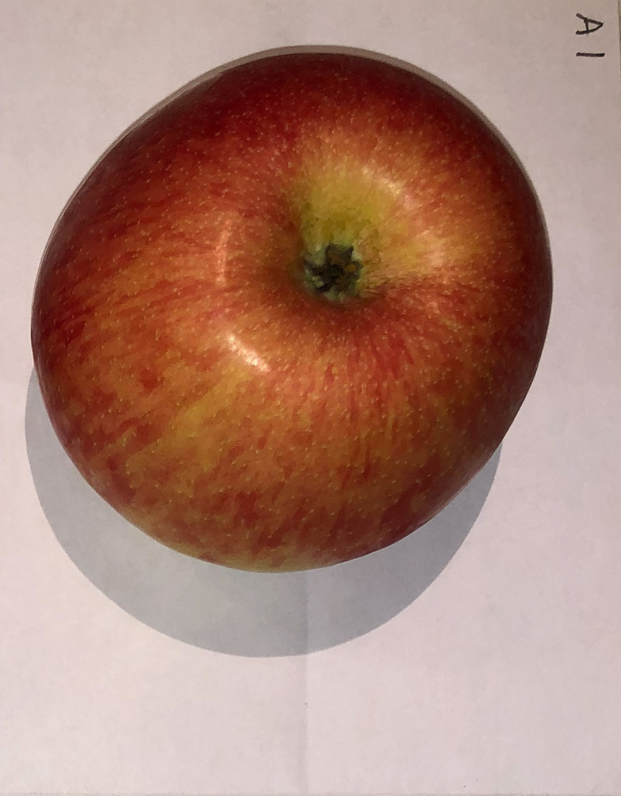
Objective of experiment and Hypothesis
Started the experiment to find simpler ways to prolong the freshness of fruits by storing them in a specific manner to reduce the food waste.
The objective of our experiment:
Evaluate the average treatment effect (ATE) of different fruit storage methods in prolonging the freshness of fruits (apples, bananas, and avocados)
Our hypothesis:
Even when these fruits are all stored at a room temperatures, how they are stored can affect the longevity of their freshness.
Notes:
We started the experiment with the hope of finding simple ways to prolong the freshness of fruits by storing them in a specific manner to reduce the food waste.
The objective of our experiment is to evaluate the average treatment effect (ATE) of different storage methods in prolonging the freshness of fruits.
We have evaluated ATE of five different fruit storage methods on apples, bananas and avocados . Our hypothesis is even when these fruits are all stored at a room temperature, how they are stored can affect the longevity of their freshness.

Slide 4
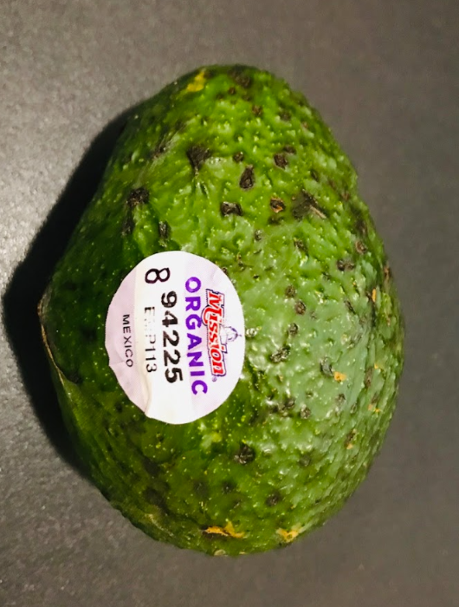
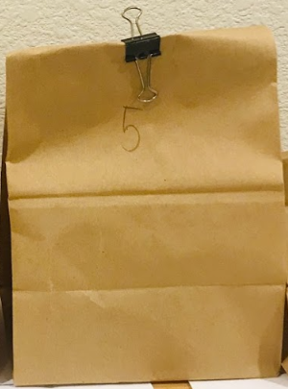
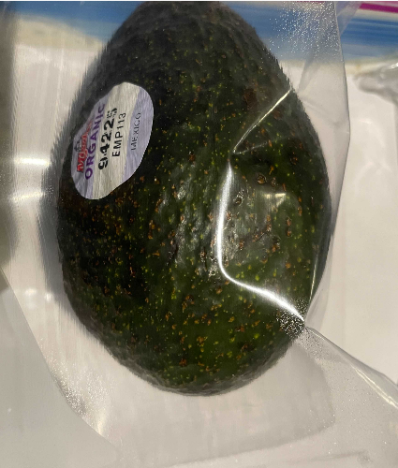
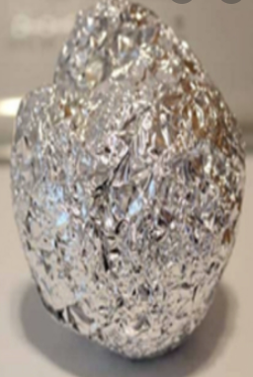
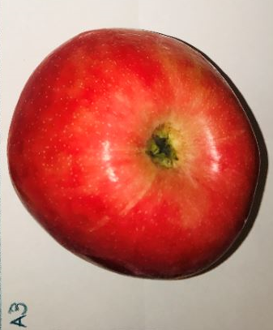
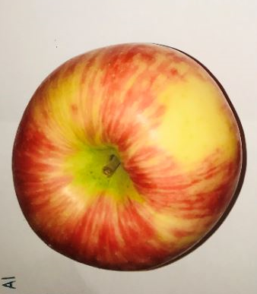
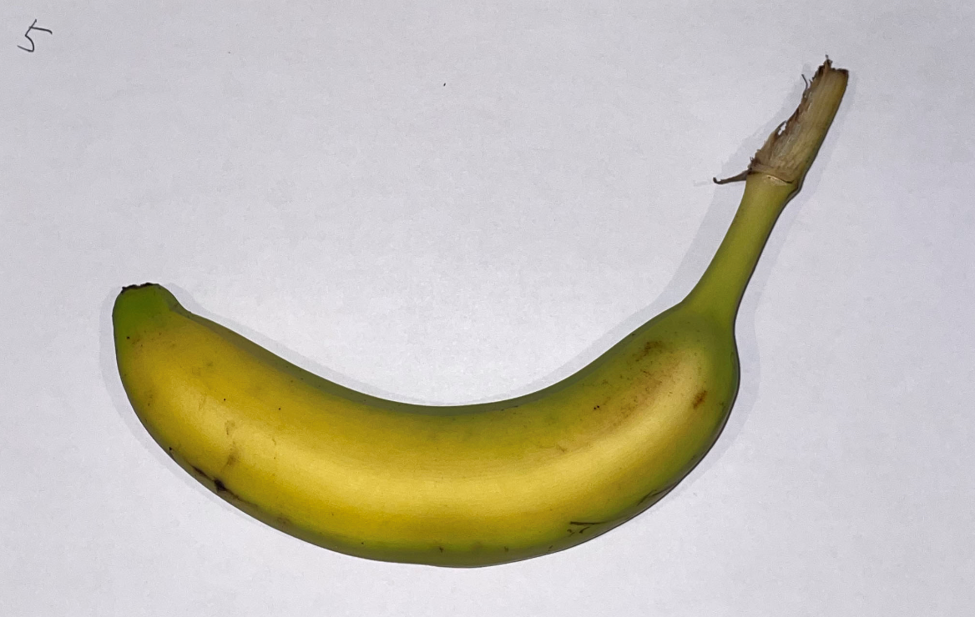
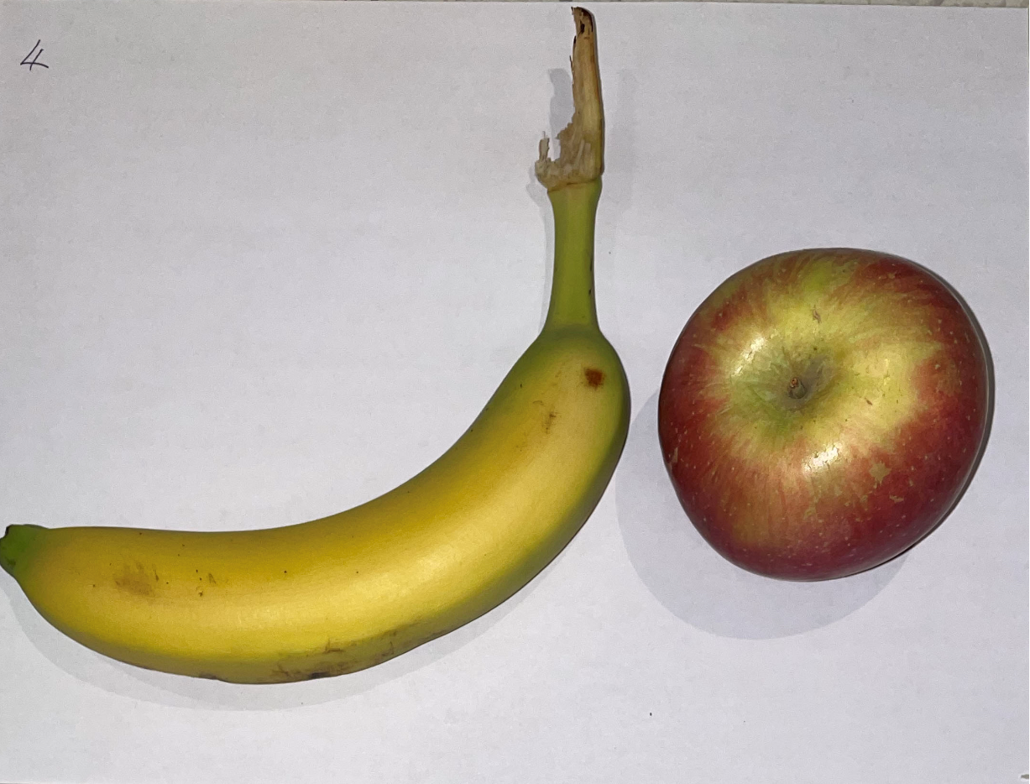
Our treatments
Avocados
Control group: Just leave them on the desk
Treatment group: Keep them in
Paper bags
Ziplocs
Aluminum foil
Bananas
Control group: Just leave them on the desk
Treatment group: leave them next to apples
Apples
Control group: upside down
Treatment group: upside up
Control
Treatment 1
Treatment 2
Treatment 3
Control
Treatment
Control
Treatment
Notes:
Let me explain our treatments
We used three fruits: Avocados, bananas and apples.
For avocados, we kept the treatment avocados in three ways for 8 days: in the paper bags, in the ziplocs, and in the aluminum foil.
For bananas, we left the treatment bananas next to apple for 10 days because it is said that ethylene gas emitted from apples will accelerate the ripening process.
For apples, we left the treatment apples upside up for 25 days. Upside up means stem end of the apples up.
Next, Justin is going to explain measurement units.

Slide 5
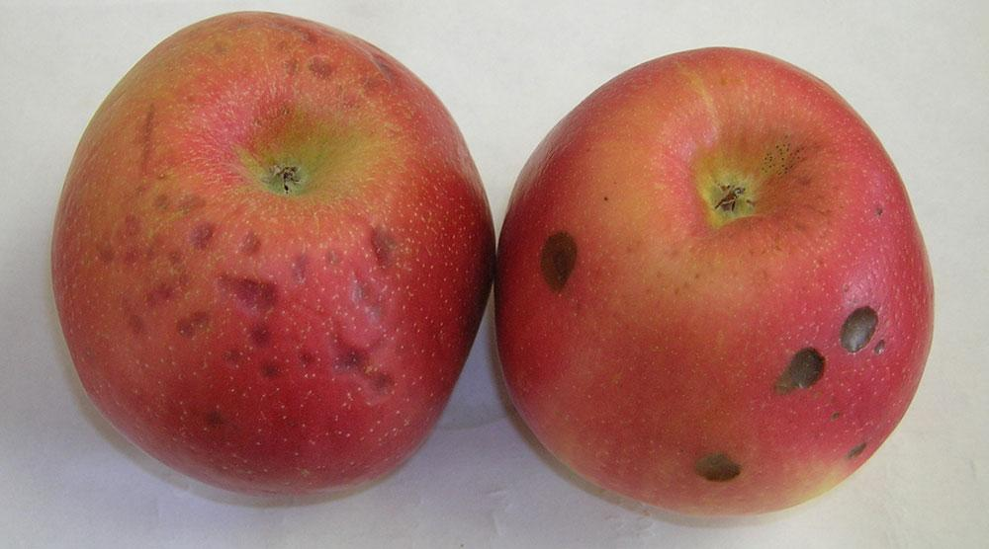
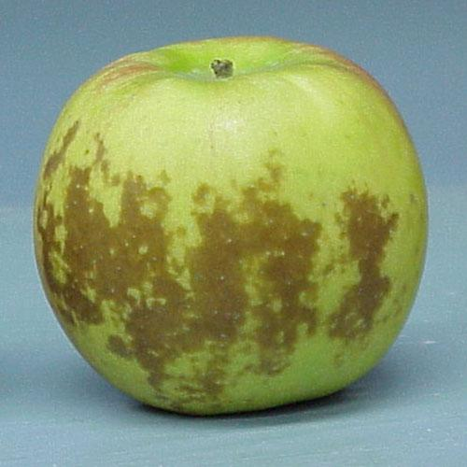
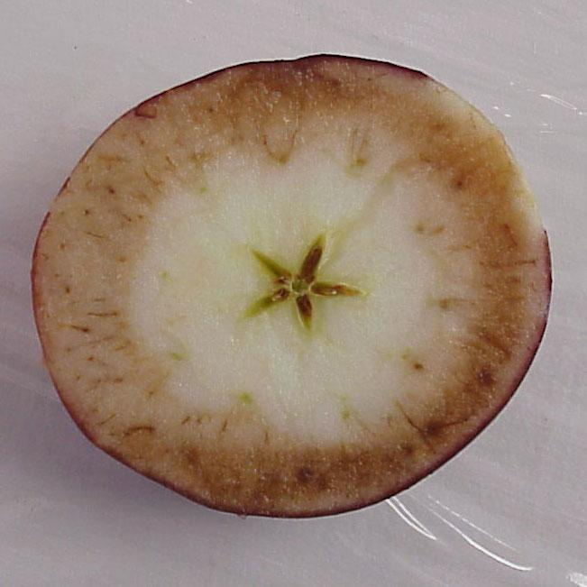
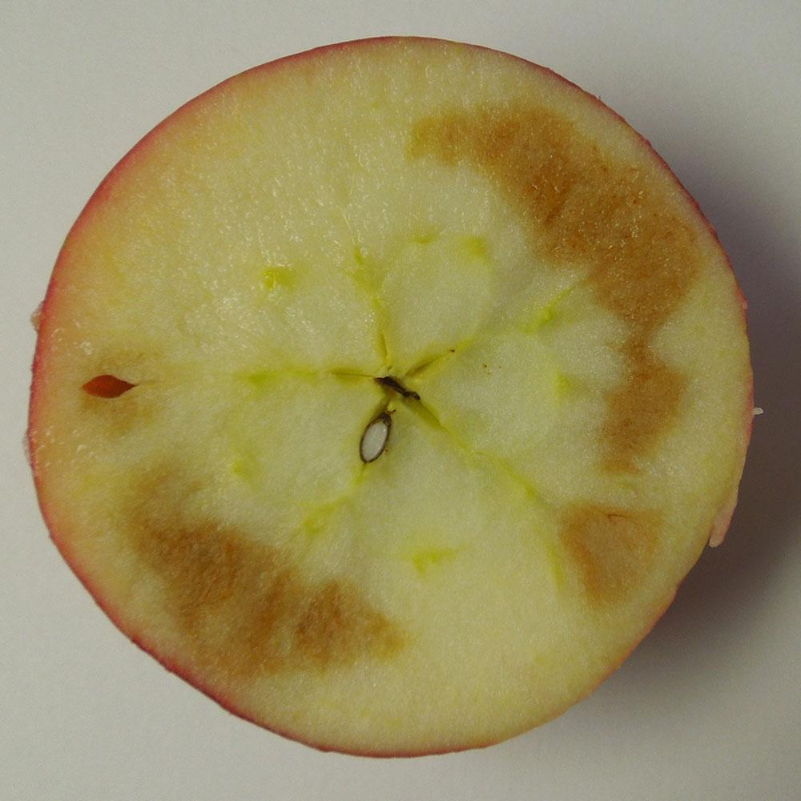
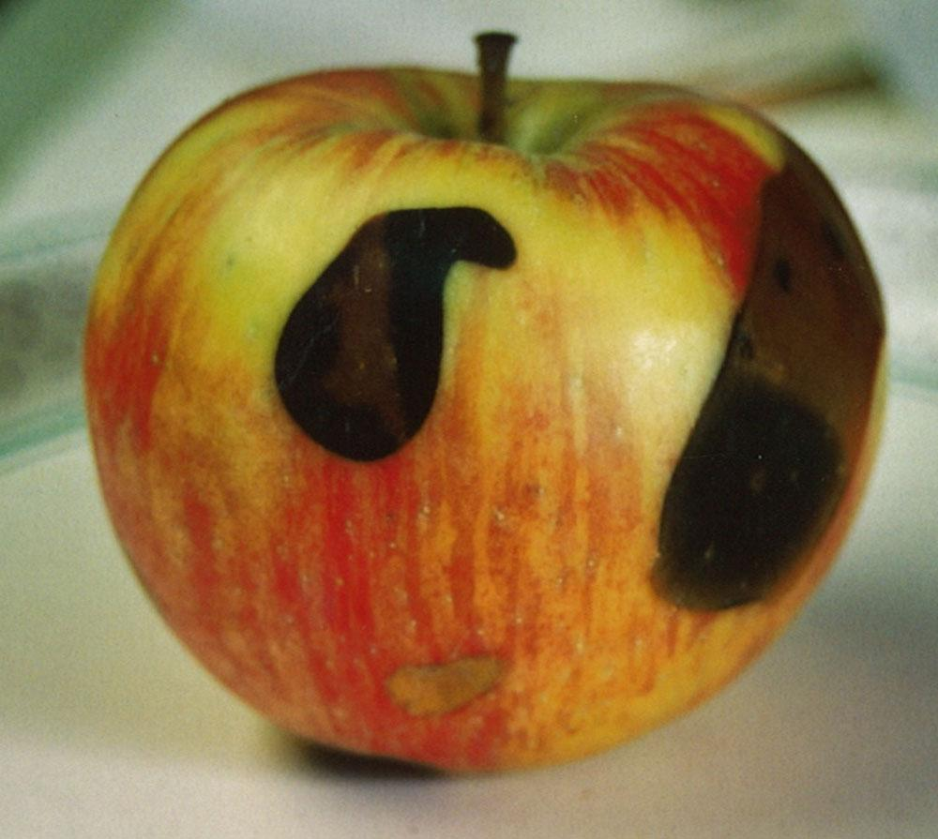
Measurement Units
In a perfect world:
Freshies®
But there is no such metric...
Operationalizing ‘Freshness’:
Brown spots are common indicators of breakdown =>
Even minor changes in external appearance can reduce consumers' sensory and hedonic expectations and encourage rejection (Hooge et al., 2017).
First attempt, browness/day
Settled on detecting a significant change in hue.
From: https://extension.umaine.edu/fruit/harvest-and-storage-of-tree-fruits/storage-disorders/
Notes:
In a perfect world, we’d use something like a Freshie, which would be some simple metric and maybe measuring device that gives you a number telling you exactly how fresh the produce is.
That doesn’t exist, so instead we focused on operationalizing freshness using human perceivable indicators. There were a couple data points that supported this...first, a lot of modes of decay result in dark spots forming on the produce. These images are from a site that describes produce storage related disorders, and although they all appear different, a common factor are the dark marks that form.
Additionally, there’s been research that even small changes in appearance can lead consumers to reject produce.
For our first attempt, we sought to measure changes in coloration over time. Second iteration: measure point at which there is a big change in coloration. Bill will explain this in a more detailed way later.

Slide 6

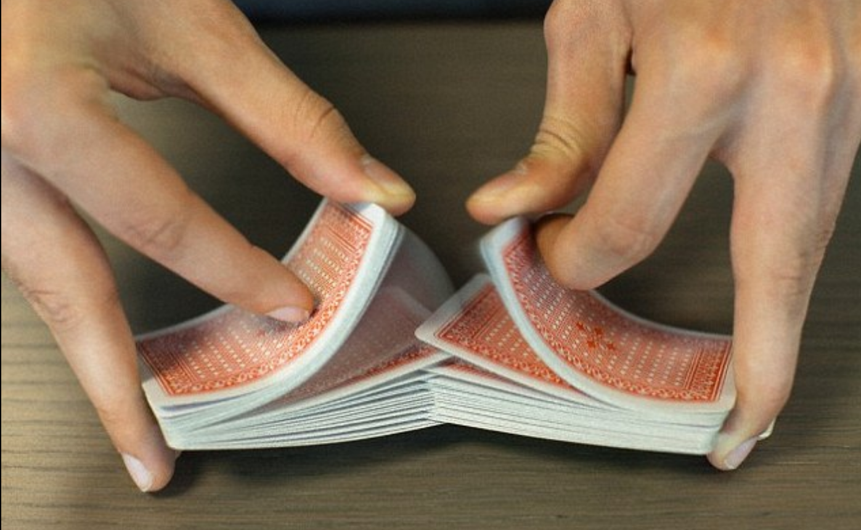
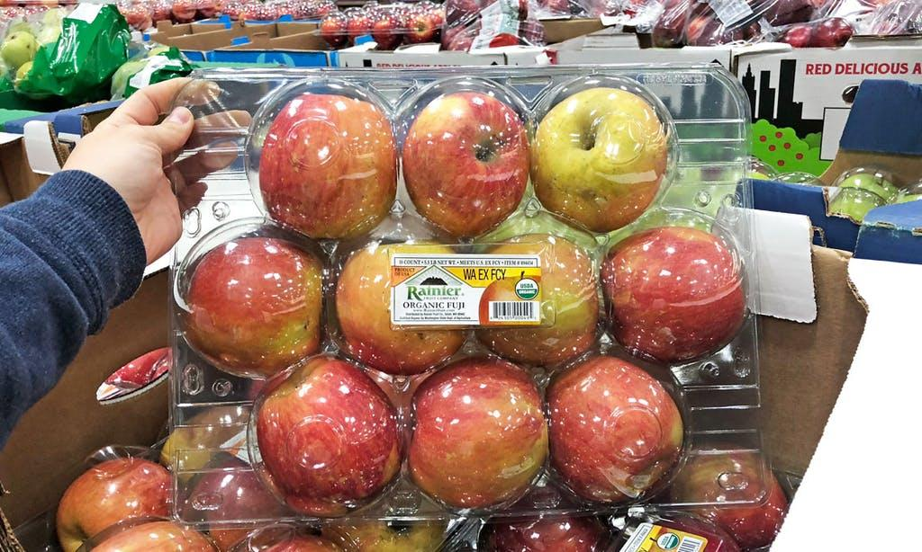
Randomization
ID
No indication from covariate (weight) that randomization was biased.
Notes:
Randomization is very simple: after we purchase the fruit, each item is given an ID, then we use a simple R sample() call to randomize assignment to treatment/control.
We have no indicators that would lead us to believe randomization was faulty. E.G. if we look at the covariate ‘weight’ prior to experimentation, we see similar distributions. (need to verify).

Slide 7
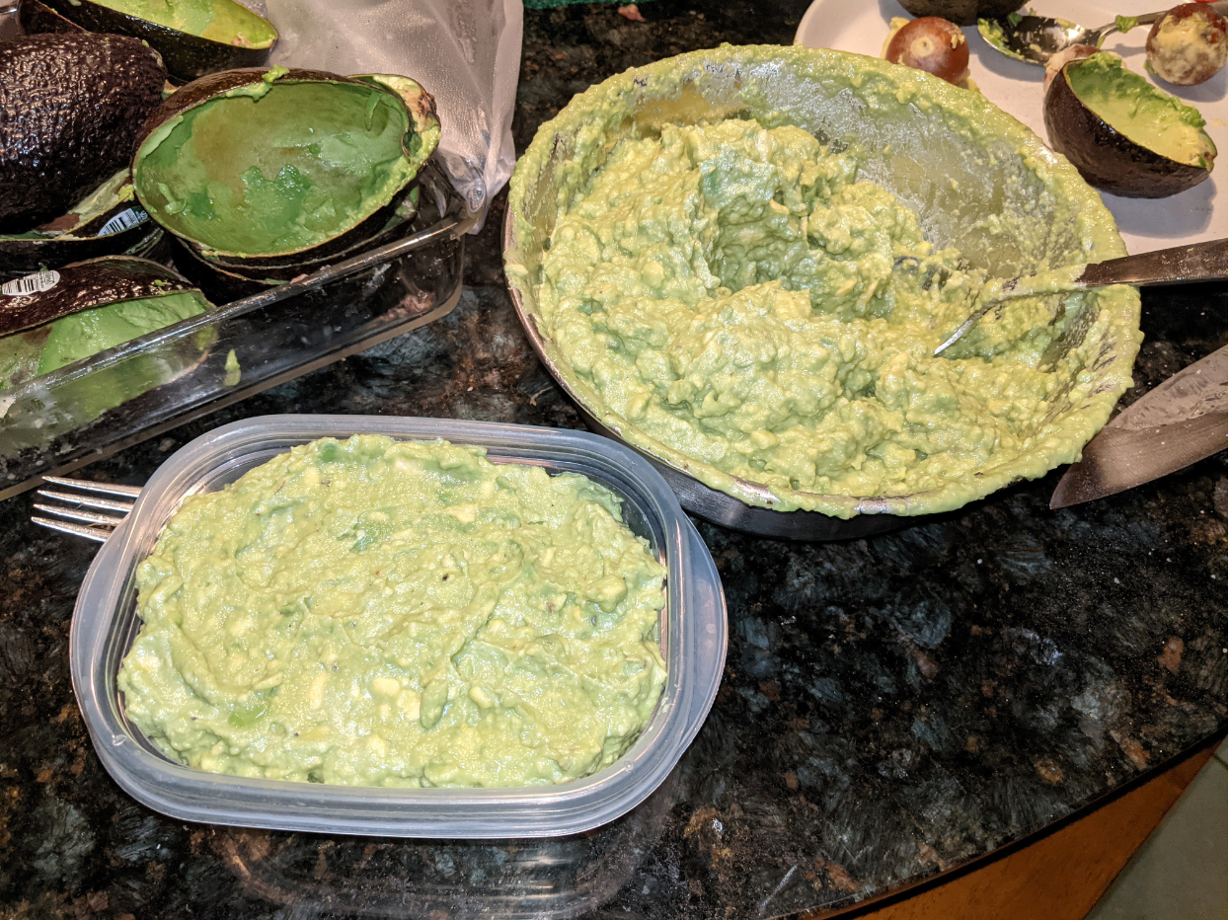
Flow Document
Subjects from Costco
N=36
Block B
N=12
Block N
N=12
Block J
N=12
Randomized Subjects
N=12
Randomized Subjects
N=12
Randomized Subjects
N=12
Control Group
N=6
Treatment Group
N=6
Control Group
N=6
Treatment Group
N=6
Control Group
N=6
Treatment Group
N=6
Daily Pictures
N=6
Daily Pictures
N=6
Daily Pictures
N=6
Daily Pictures
N=6
Daily Pictures
N=6
Daily Pictures
N=6
Notes:
This is a flow document describing how subjects came in to our experiments. This is roughly the same flow we used for all experiments, starting with subjects we purchased from costco as the basis for our randomization blocks. Each subject was randomized into control or treatment, as I described on the last slide. And for each of these subjects we captured daily images and covariate measurements. In the end, some of the subjects became guacamole.

Slide 8
Experiment Design
Bananas
Avocados
R | XO | XO | XO | XO | XO | XO | XO | XO | XO | XO
R | -O | -O | -O | -O | -O | -O | -O | -O | -O | -O
R | XO
R | -O
Between subjects comparison: items are only ever assigned to treatment or control.
Notes:
Here’s an overview of our experimental design.
It’s a relatively straight forward experiment, so our RXO grammar is pretty straight-forward as well. We do not change the treatment status of individuals over the course of the experiment, and consequently we’d call these between-subject comparisons.
Between subjects comparison: items are only ever assigned to treatment or control. We do track change over time, so we might consider it to be borderline Within-subjects, but the administration of the treatment always happens consistently at the beginning of the experiment.

Slide 9
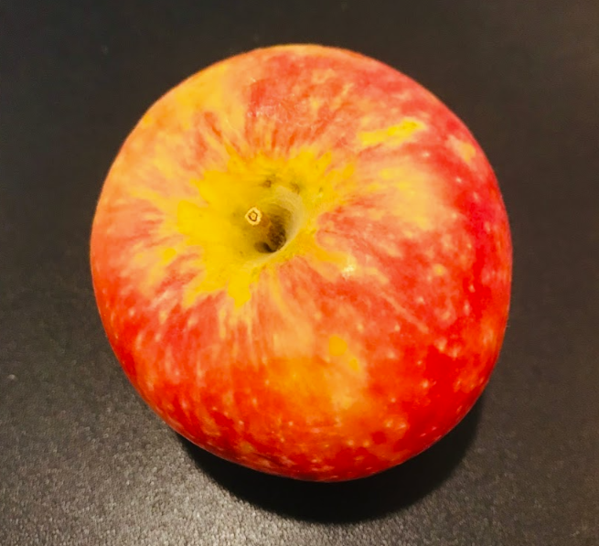
Image processing
EDA and Data Cleaning
Analysis
Subject | Response 1 | Response 2 | Response 3
Apple | NA | NA | NA
Banana | d_turn | Weight
Avocado | hue_turn | black_ratio | Weight
We used apple for our pre-experiment and did not use apple during the main experiment
Color remain unchanged even after 25 days.
Used avocado and banana for our main experiment.
Will focus on reporting on the findings from avocado experiment and will briefly talk the findings from analyzing the banana data at the end if there is time
Picture taken on 12/1/2020
Notes:
Finally, these are the response variables we used. We started with a pre-experiment using apples, and found that although we took pictures every day, the external color did not change much. It turns out that apples can last a long time sitting on a counter at room temperature. So we used bananas and avocados, two fruits known for turning brown relatively quickly. For bananas, we tracked their weight at the beginning and end of the experiment, as well as the day they ‘turned dark’. This is a value we derive from some image manipulation and analysis that bill will explain later.
For avocados, we also tracked before/after weight. However, since we only cut them once and took a single image, we had a couple other metrics that we used for response variable, hue_turn and black_ratio. So now I’ll let Bill explain how we arrived at these metrics and the analysis.

Slide 10

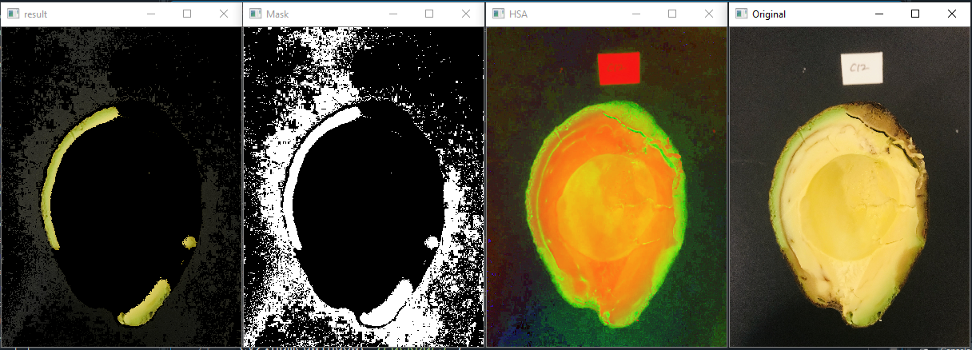
Image processing
EDA and Data Cleaning
Analysis
Original
Decomposed into Hue, Value and Saturation
Filter
Filtered
Fixed the condition that we are interested, which is the green part at the end of 8 days and measure the deviation from the target condition in a subjective and reproducible way.
We created filter using different values of Hue.

Slide 11
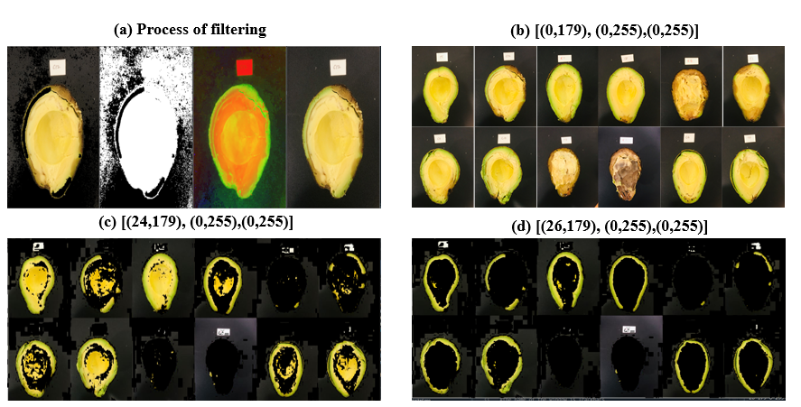
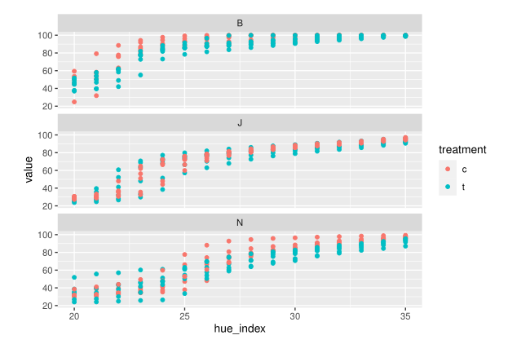
Image processing
EDA and Data Cleaning
Analysis
Minimum Hue = 24
Changes in black-ratio as function of hue
Minimum Hue = 26

Slide 12
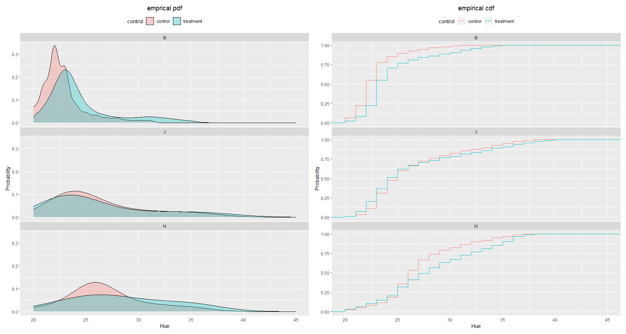
Image processing
EDA and Data Cleaning
Analysis

Slide 13
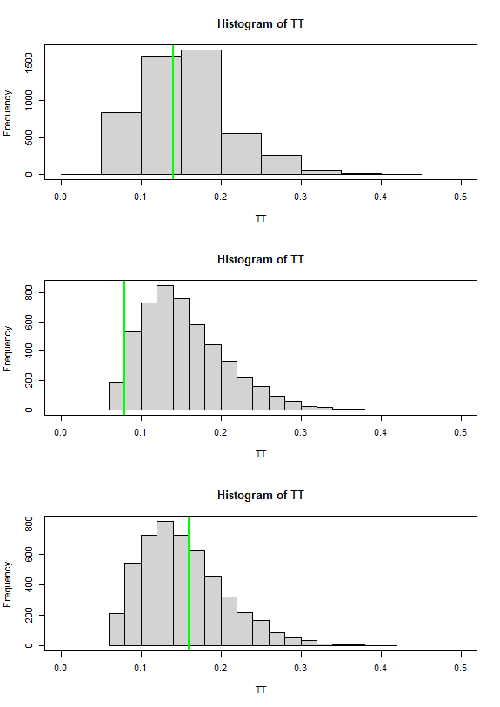
Image processing
EDA and Data Cleaning
Analysis
B
Perform permutation (5000 times) tests based on the KS test statistic
J
N

Slide 14
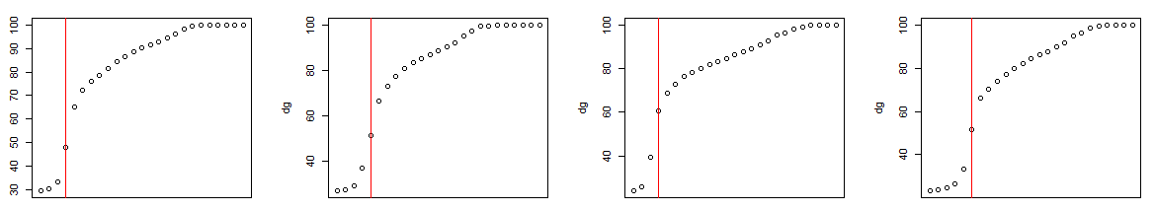
Image processing
EDA and Data Cleaning
Analysis
Subject | Response 1
Avocado | Hue_turn
Banana | d_turn
Apple | NA
Used CUMSUM method
Used Bayesian Change point detection method

Slide 15
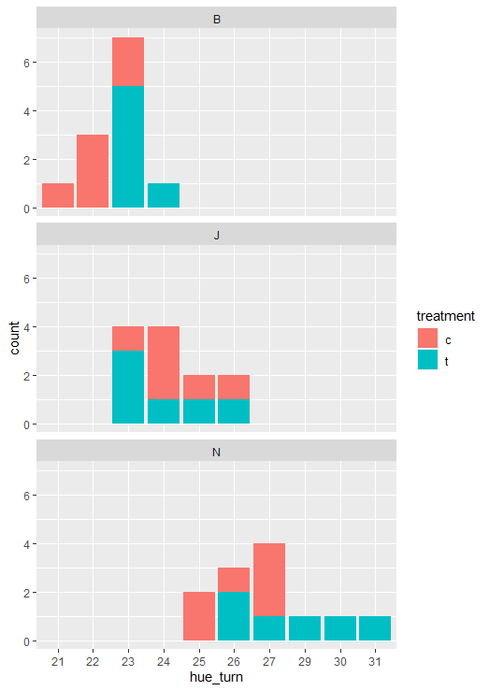
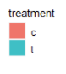
Image processing
EDA and Data Cleaning
Analysis
short | as.factor(treatment) + as.factor(block)
long | as.factor(treatment)*as.factor(block)
Block | Treat? | Hue_turn
B | c | 22
B | t | 23
J | c | 24
J | t | 24
N | c | 26
N | t | 28
Parameter | short | long
constant | 22.2*** | 22.17***
treatment | 0.889** | 1.00
J | 1.5*** | 2.167***
N | 4.5*** | 4***
t:J |  | -1.33
t:N |  | 1

Slide 16
Image processing
EDA and Data Cleaning
Analysis
mod_1 | as.factor(treatment) + as.factor(block)
mod_2 | as.factor(treatment)*as.factor(block)
Block | Treat? | Hue_turn
B | c | 22
B | t | 23
J | c | 24
J | t | 24
N | c | 26
N | t | 28
Parameter | short | long
constant | 22.2*** | 22.17***
treatment | 0.889** | 1.00
J | 1.5*** | 2.167***
N | 4.5*** | 4***
t:J |  | -1.33
t:N |  | 1
 | 24.59 | 24

Slide 17
Image processing
EDA and Data Cleaning
Analysis
mod_1 | as.factor(treatment) + as.factor(block)
mod_2 | as.factor(treatment)*as.factor(block)
Block | Treat? | Hue_turn
B | c | 22
B | t | 23
J | c | 24
J | t | 24
N | c | 26
N | t | 28
Parameter | short | long
constant | 22.2*** | 22.17***
treatment | 0.889** | 1.00
J | 1.5*** | 2.167***
N | 4.5*** | 4***
t:J |  | -1.33
t:N |  | 1
 | 24.59 | 24
 | 27.59 | 28.17

Slide 18
Image processing
EDA and Data Cleaning
Analysis
Response | Result
KS test | NO
Hue_turn | yes
Weight | YES
Is there treatment effect?

Slide 19
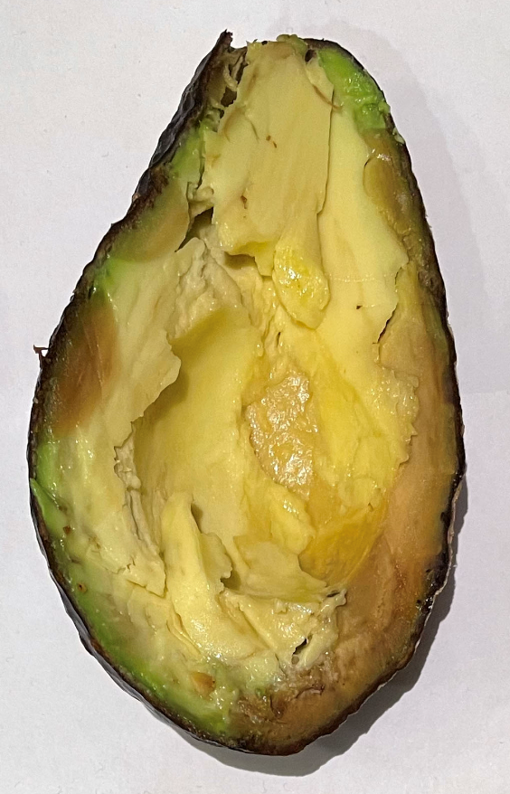
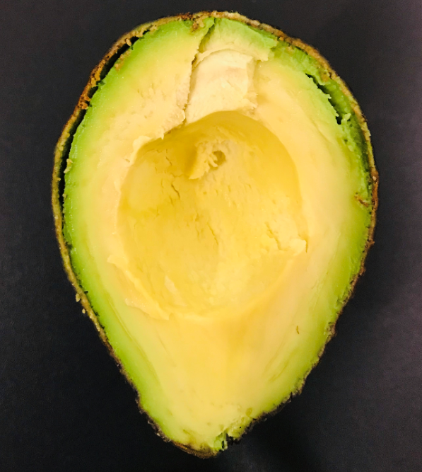
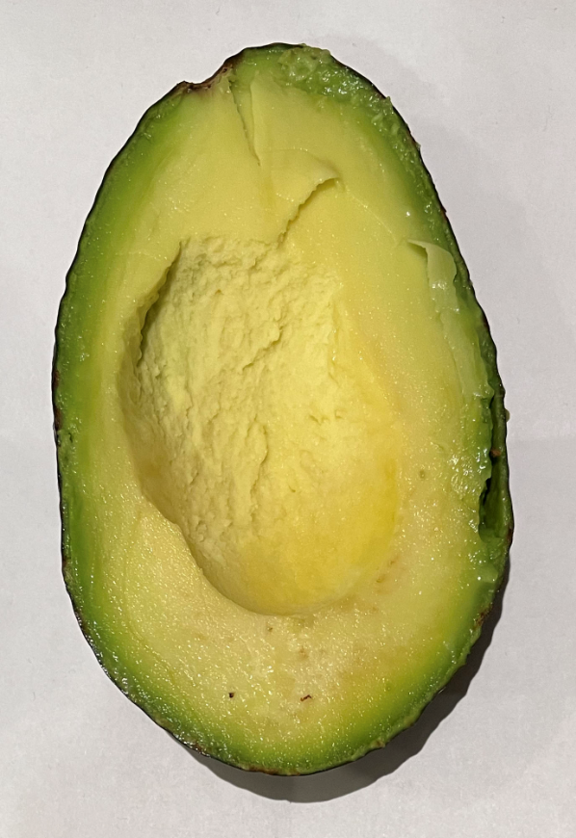
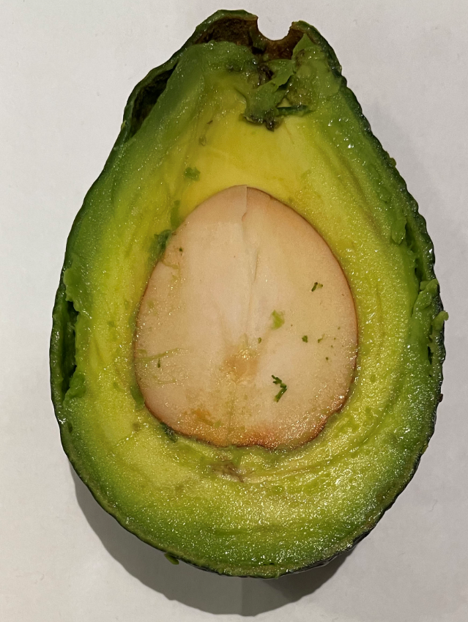
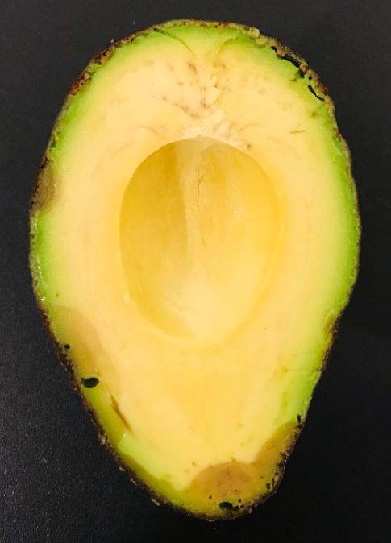
Image processing
EDA and Data Cleaning
Analysis
Which one would you eat?
1
2
3
4
5

Slide 20
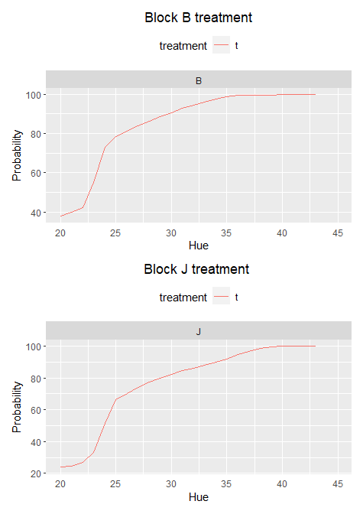
Concluding remarks
Single value response may not be able to capture the treatment effect that you wish to capture
Rather than using a scalar value, using a vector or hyperplane can be a solution.

Slide 21
Concluding remarks
Single value response may not be able to capture the treatment effect that you wish to capture
Rather than using a scalar value, using a vector or hyperplane can be a solution.
When you buy avocado, wrapping in a paper bag or aluminum foil can help. Don’t put them inside a plastic bag
Control
Treatment 1
Treatment 2
Treatment 3

Slide 22
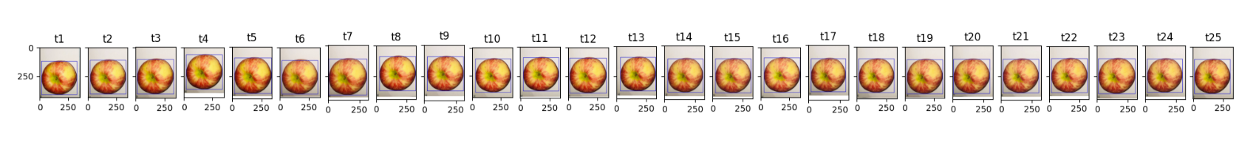
Concluding remarks
Purchased on : 10/25/20
Condition on : 12/01/20
Single value response may not be able to capture the treatment effect that you wish to capture
Rather than using a scalar value, using a vector or hyperplane can a solution.
When you buy avocado, wrapping in a paper bag can help. Don’t put them inside a plastic bag
When you buy apple, you can leave it at room temperature for a long time.

Slide 23
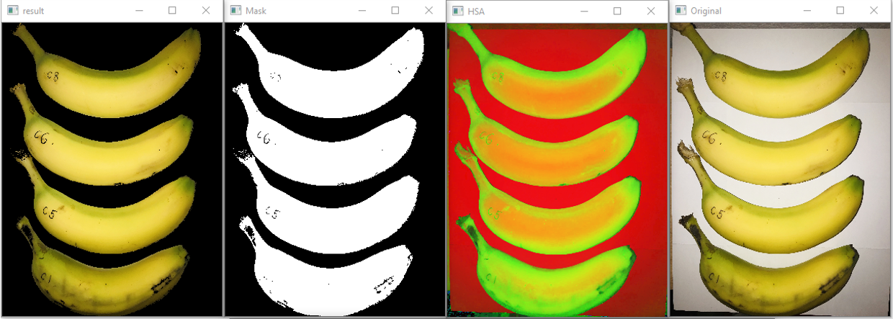
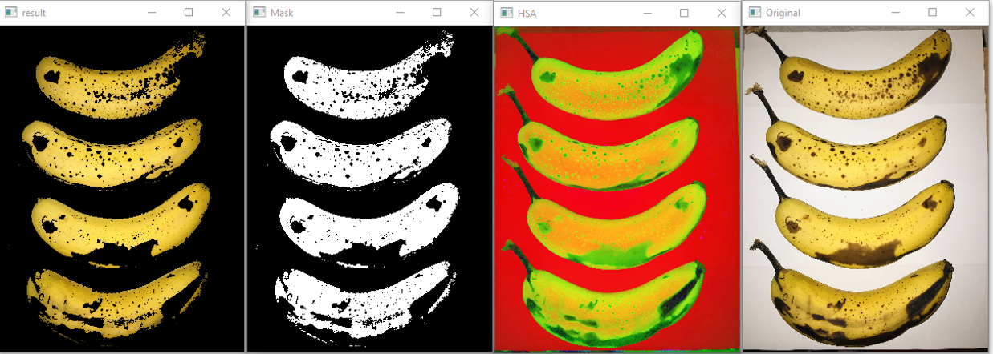
Concluding remarks
Day 1
Single value response may not be able to capture the treatment effect that you wish to capture
Rather than using a scalar value, using a vector or hyperplane can a solution.
When you buy avocado, wrapping in a paper bag can help. Don’t put them inside a plastic bag
When you buy apple, you can leave it at room temperature for a long time.
If you want find out about our finding from analyzing the banana data, please visit the github page that will be available after Dec 17th.
Day 10

Slide 24
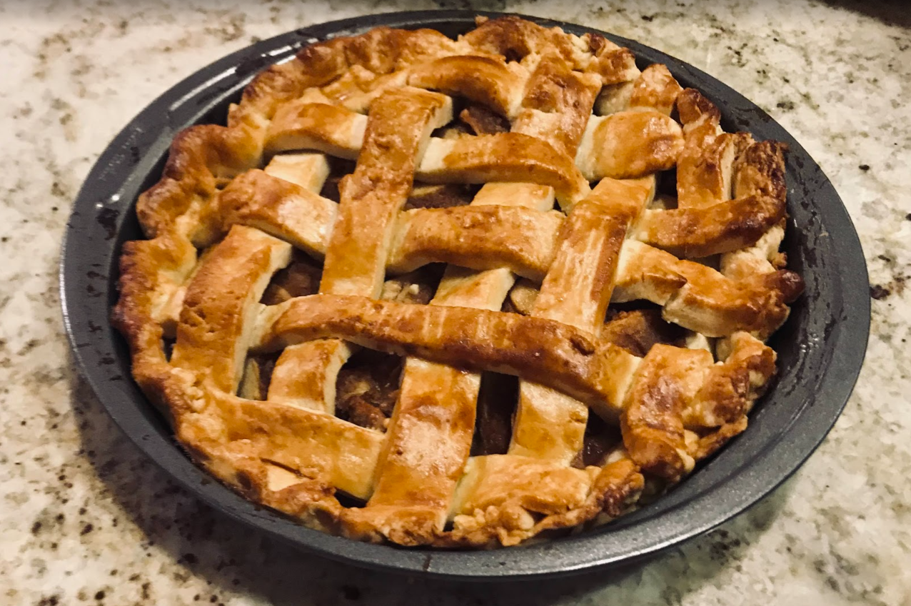
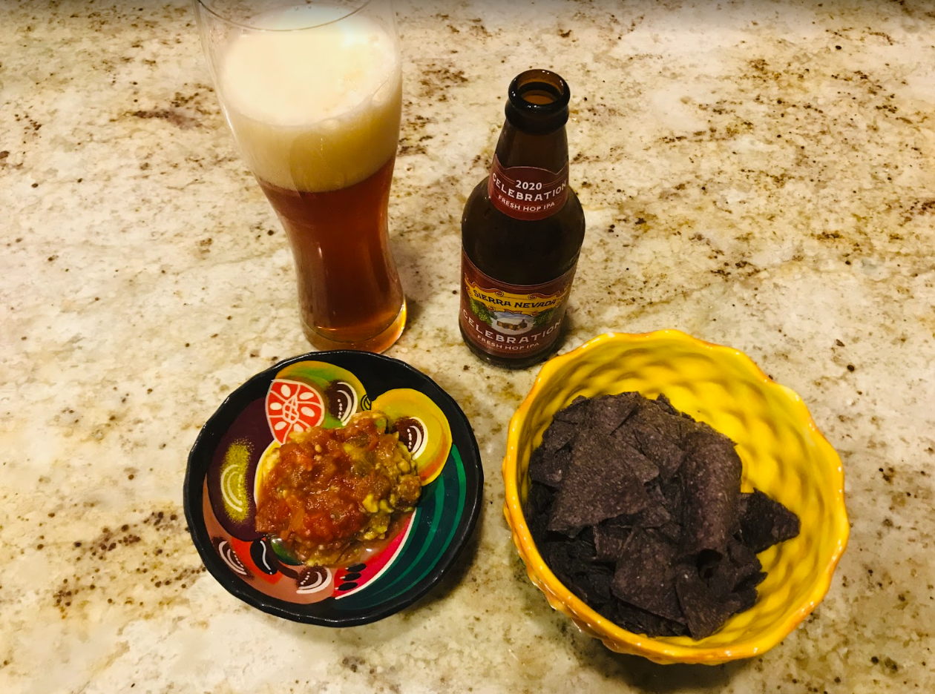
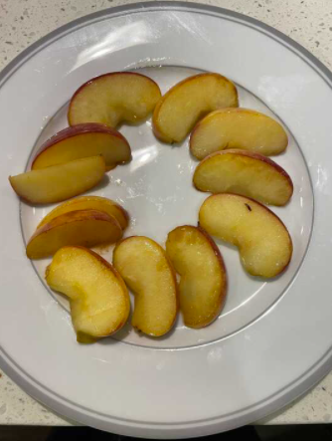
Thank you

